Slide 1
Meeting 23/06/2020
Naudé Conradie
19673418

Slide 2
Size Variance
Constants
Resolution
Pressure
Variable | Ratio
Enforced
Dimensions | 20x20 | 200x200
Displacement | 1 | 10
Results
Reaction Force | 1 | 10
Constraint Energy | 1 | 100
Strain Energy | 1 | 1

Slide 3
Resolution Variance
Constants
Dimensions
Displacement
Pressure
Variable | Ratio
Enforced
Resolution | 5x5 | 10x10
Results
Reaction Force | 1 | 1,005
Constraint Energy | 1 | 1,05
Strain Energy | 1 | 3-5

Slide 4
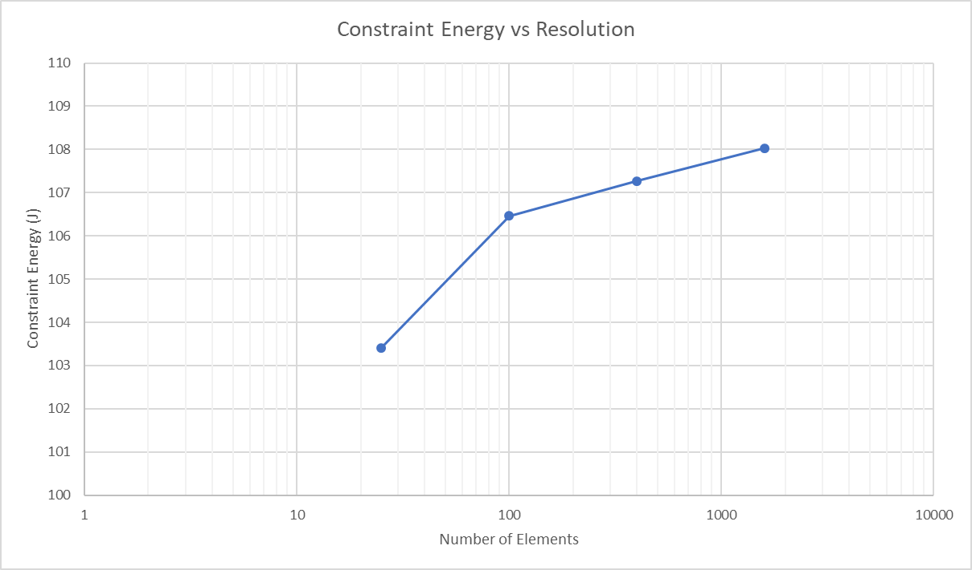
Resolution Variance

Slide 5
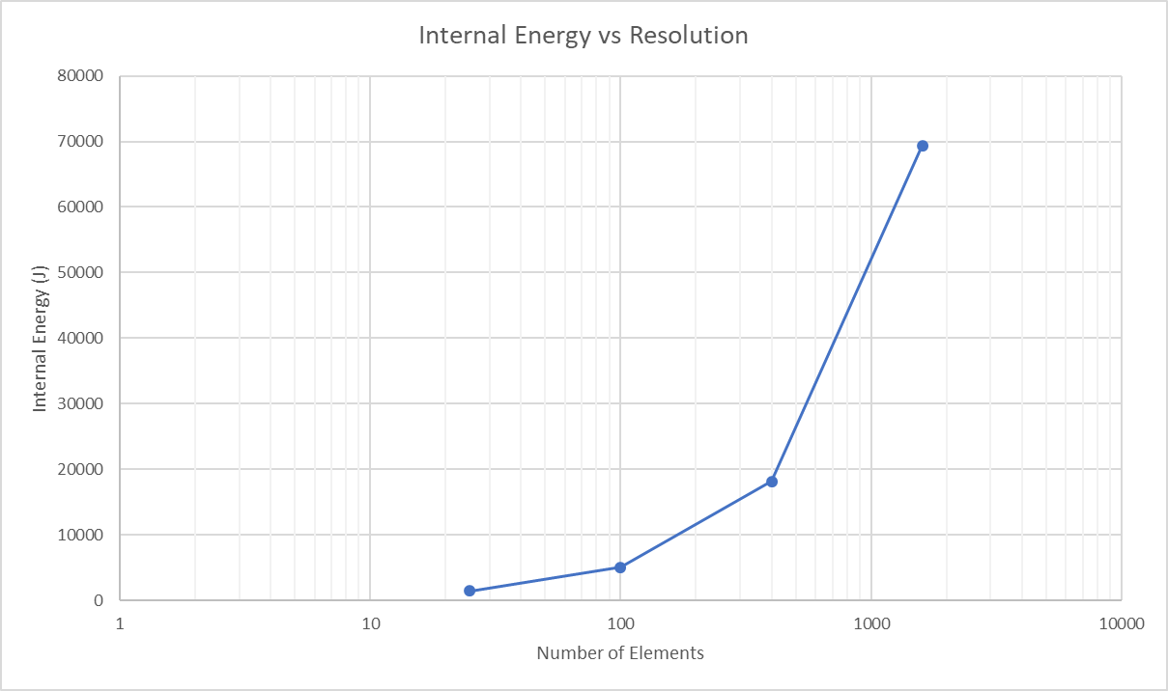
Resolution Variance

Slide 6
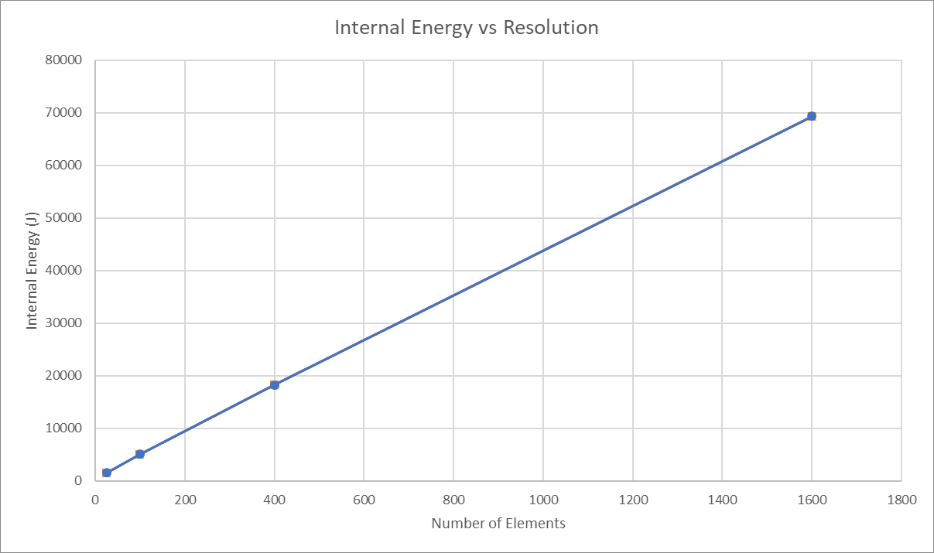
Resolution Variance

Slide 7
Code
Pressure variance
Simulations fail at relatively low pressures (0.5 - 1 bar)
Simulations don’t deform massively at lower pressures (0.1 bar)
Add solid neighbouring grids
Add during template creation
Allows for higher pressures to be applied

Slide 8
Admin
Lab access
PhD

